Slide 1
Internship At Concept Soft SWE 420
Debasish Mohan Singha
2018831045
Department of Software Engineering
IICT,SUST

Slide 2
About Concept Soft
Founded in 2019
7 employees
Operates remotes with employees around the world
Focuses on android audio apps and games

Slide 3
Internship Activities
Adapting to professional work environments
Learning android software Tools
Learning audio engineering concepts
Working on Real world apps
Writing documentation and proper coding and design guidelines

Slide 4
Adapting to professional work environments
Showed proper manners and sincerity while communicating with others
Punctually attended every daily, weekly and monthly meetings
Followed every advice given at work to improve my own workflow
Properly communicated any issues I faced

Slide 5
Work environment at Concept Soft
Amazing experience as every employees were very friendly and helpful to me
Always took every feedback of mine very sincerely and worked on them
Gave very flexible schedule
Always keep track of progress in the app to give guidelines if needed

Slide 6
Learning android software Tools
Followed tutorial resources given by supervisor
Built test android projects
Learning JNI and fmod api

Slide 7
Learning audio engineering concepts
Learnt a considerable amount about several audio concepts like audio processing, formatting, adding effects etc.
Learned about how to change audio effect to make them sound different as needed to the app

Slide 8
Working on Real world apps
Worked on voice effect changer apps
Worked on backend fmod api to build audio functions to add voice changing effect to the app
Worked on UI elements like seekbar, audio list, audio waveform ,export dialog,buttons etc. to make them look similar to design

Slide 9
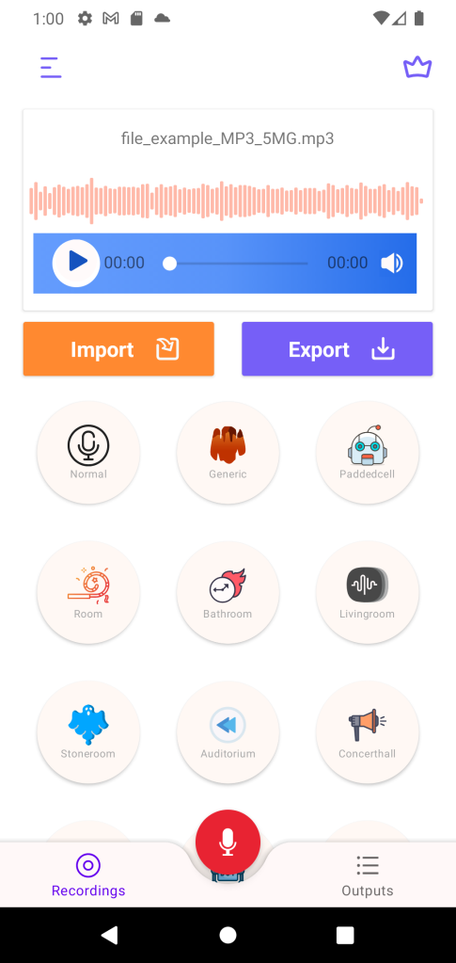
Test demo picture of voice changer app

Slide 10
Writing Documentation
Wrote documentations in Jira for the voice effect changer app
Wrote small blog or documents for many concepts or tools I learned
Wrote in jira board to write progress on every features I worked on or needed revisions or still left to do

Slide 11
Following proper coding and design guidelines
Learned many UI design guidelines from material design
Learned Proper way of writing codes so the app runs well optimized
Writing documents well so others can follow easily

Slide 12
Conclusion
Helped me connect my academic skills to industry skills
Become more confident and focused in my work and family life
Will always be an unforgettable experience

Slide 13
Thank You!

